Slide 1
Event Masking Latent Model
Christian M. Adriano (Chris)
christian.adriano@hpi.de
Notes:
https://en.wikipedia.org/wiki/Transduction_(machine_learning)

Slide 2
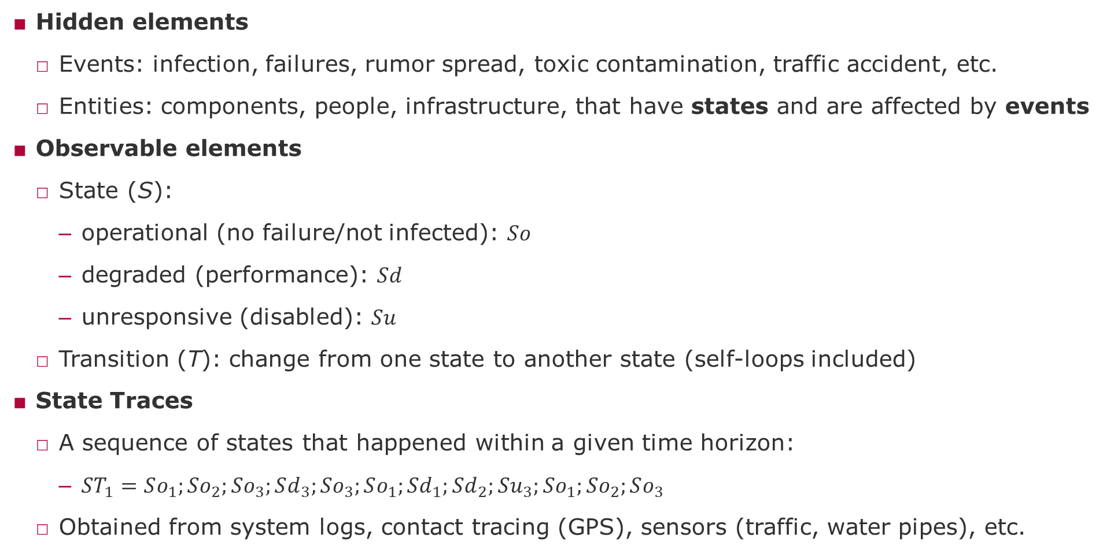
Definitions
Hidden elements
Events: infection, failures, rumor spread, toxic contamination, traffic accident, etc.
Entities: components, people, infrastructure, that have states and are affected by events
Observable elements
State (S):
operational (no failure/not infected): $So$
degraded (performance): $Sd$
unresponsive (disabled): $Su$
Transition (T): change from one state to another state (self-loops included)
State Traces
A sequence of states that happened within a given time horizon:
$ST_{1}=So_{1};So_{2};So_{3};Sd_{3};So_{3};So_{1};Sd_{1};Sd_{2};Su_{3};So_{1};So_{2};So_{3}$
Obtained from system logs, contact tracing (GPS), sensors (traffic, water pipes), etc.

Slide 3
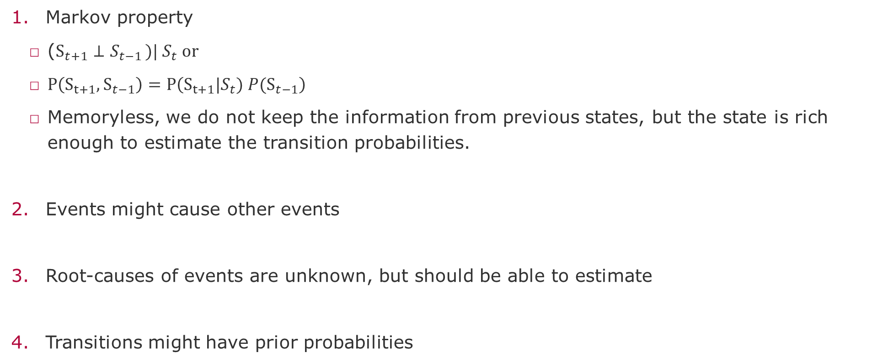
Assumptions
Markov property
($S_{t+1}⊥S_{t−1 })| S_{t} or$
$P\left(S_{t+1},S_{t−1}\right)=P\left(S_{t+1}|S_{t}) P(S_{t−1}\right)$
Memoryless, we do not keep the information from previous states, but the state is rich enough to estimate the transition probabilities.
Events might cause other events
Root-causes of events are unknown, but should be able to estimate
Transitions might have prior probabilities

Slide 4
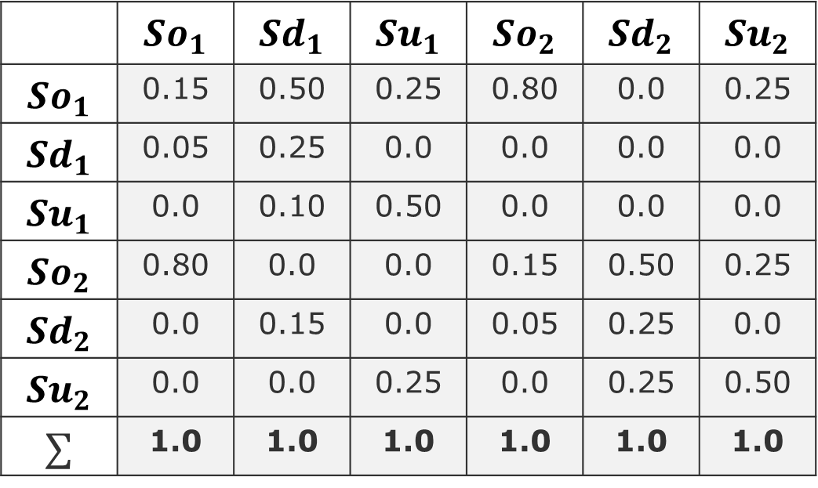
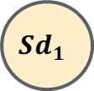
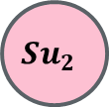

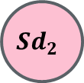
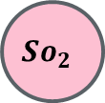

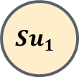
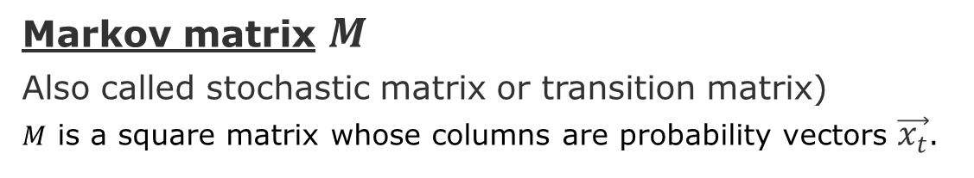
Example of Markov Chain
Markov matrix $M$
Also called stochastic matrix or transition matrix)
$M$ is a square matrix whose columns are probability vectors $\vec{x_{t}}$.
$$So_{1}$$
$$Sd_{1}$$
$$\vec{x_{t}}$$
$$Su_{1}$$
Source states
 | $$So_{1}$$ | $$Sd_{1}$$ | $$Su_{1}$$ | $$So_{2}$$ | $$Sd_{2}$$ | $$Su_{2}$$
$$So_{1}$$ | 0.15 | 0.50 | 0.25 | 0.80 | 0.0 | 0.25
$$Sd_{1}$$ | 0.05 | 0.25 | 0.0 | 0.0 | 0.0 | 0.0
$$Su_{1}$$ | 0.0 | 0.10 | 0.50 | 0.0 | 0.0 | 0.0
$$So_{2}$$ | 0.80 | 0.0 | 0.0 | 0.15 | 0.50 | 0.25
$$Sd_{2}$$ | 0.0 | 0.15 | 0.0 | 0.05 | 0.25 | 0.0
$$Su_{2}$$ | 0.0 | 0.0 | 0.25 | 0.0 | 0.25 | 0.50
$$∑$$ | 1.0 | 1.0 | 1.0 | 1.0 | 1.0 | 1.0
$$Su_{2}$$
$$So_{2}$$
$$Sd_{2}$$
Target states
Intentionally not showing the self-loops

Slide 5
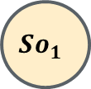
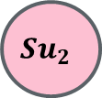

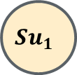
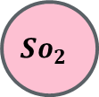
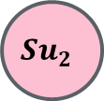
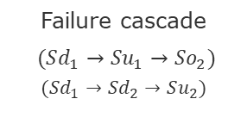
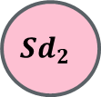

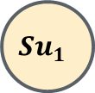

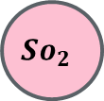


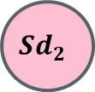
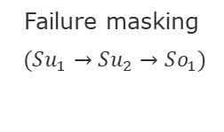
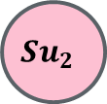

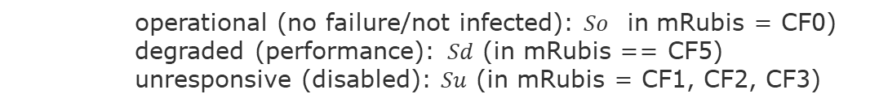
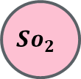
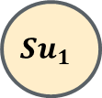
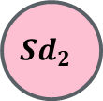
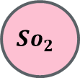
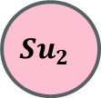
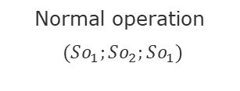
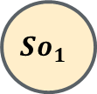

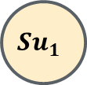






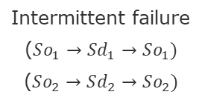

Types of Traces
operational (no failure/not infected): $So$ in mRubis = CF0)
degraded (performance): $Sd$ (in mRubis == CF5)
unresponsive (disabled): $Su$ (in mRubis = CF1, CF2, CF3)
$$So_{1}$$
$$Sd_{1}$$
$$So_{1}$$
$$Sd_{1}$$
$$So_{1}$$
$$Sd_{1}$$
$$So_{1}$$
$$Sd_{1}$$
$$So_{1}$$
$$Sd_{1}$$
$$Su_{1}$$
$$Su_{1}$$
$$Su_{1}$$
$$Su_{1}$$
$$Su_{1}$$
$$Su_{2}$$
$$Su_{2}$$
$$Su_{2}$$
$$Su_{2}$$
$$Su_{2}$$
$$So_{2}$$
$$Sd_{2}$$
$$So_{2}$$
$$Sd_{2}$$
$$So_{2}$$
$$Sd_{2}$$
$$So_{2}$$
$$Sd_{2}$$
$$So_{2}$$
$$Sd_{2}$$
Normal operation
$(So_{1};So_{2};So_{1})$
Intermittent failure
($So_{1}→Sd_{1}→So_{1})$
($So_{2}→Sd_{2}→So_{2})$
Systemic degradation
($Sd_{1}→Sd_{2})$
Failure masking
$(Su_{1}→Su_{2}→So_{1})$
Failure cascade
$(Sd_{1}→Su_{1}→So_{2})$
$$(Sd_{1}→Sd_{2}→Su_{2})$$

Slide 6
End

Slide 7
Supervisory Component

